Slide 1
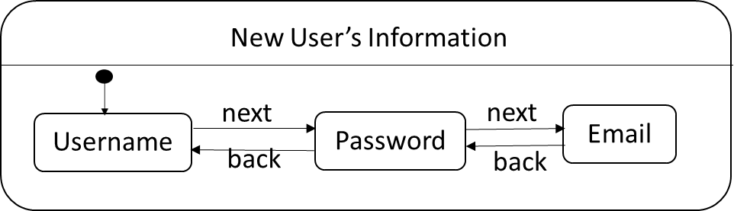



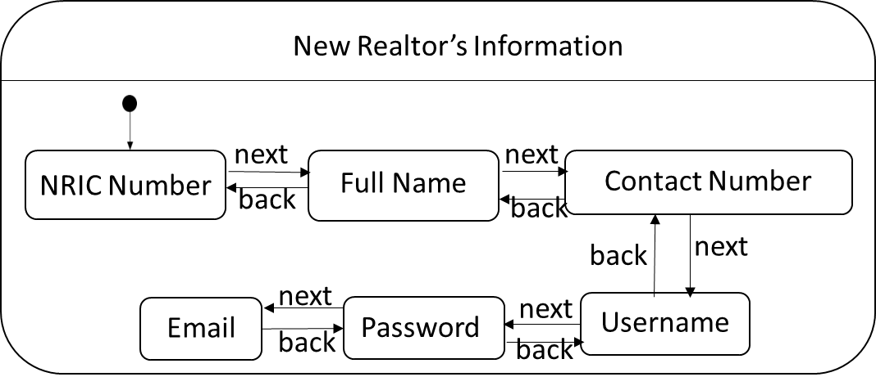
Return
Enter
Choose
Choose
New User
Realtor’s Profile
Return
Exit
Sign-Up Page
CV
Enter
View
Return
Main Menu
Return
Failed Sign Up
Rate
Success
Choose
Return
Realtor
Search
Login as
Return
Login Page
Return
Logout
Choose
Choose
CV
CV
Normal User
Realtor
Return
Return
CV
Update
Search
Apartments
Watch List
CV
Notify
Compare
View
Success
Enter
Failed Sign up
Return
CV
Price Change
View
Add To
Apartment Listings
Return
Post
Delete
Return

Slide 2


New User’s Information
next
Username
Password
Email
back
New Realtor’s Information
next
next
NRIC Number
back
Full Name
Contact Number
back
back
next
next
next
Email
Password
Username
back
back

